Slide 1


Automation and Maintenance Management Systems
SMART INSTRUMENTATION FOR THE WATER INDUSTRY
Technology to meet India’s water monitoring needs
Hugo Schmalz
&
Prakash Muthuswamy
Notes:
This presentation demonstrates the new capabilities of PowerPoint and it is best viewed in Slide Show. These slides are designed to give you great ideas for the presentations you’ll create in PowerPoint 2010!
For more sample templates, click the File tab, and then on the New tab, click Sample Templates.

Slide 2
Yad Yad Aacharathi Sreshta: Tattadeva Itharo Jana:
Congratulations to CWPRS on Centenary Year
Thank you for the opportunity to be part of this significant journey
For the water industry, NHP is a great opportunity
And a significant responsibility

Slide 3

Our Water Industry Challenges
Rivers & Irrigation Canals
Reliable, maintainable sensor technology that will meet the project objectives
Right sensor for the right application.
Flood management and protection of citizens with appropriate early warning through rain gauging, level sensing and telemetry.
Accurate monitoring for our rivers, canals and catchments.
Measuring through the challenge of sedimentation.
Pollution monitoring.
Using current technology to bring reliable data to the decision takers.
Web based monitoring and control solutions.
Analytical tools which will help you to interpret the data using Key Performance Indicators

Slide 4
We Provide
Appropriate sensor technology for monitoring, for each application.
Assistance in selecting the right technology for your application.
Flow surveys and meter verifications using portable equipment.
Installation suitable for your site conditions, such as power sources, wired or wireless monitoring solutions.
German technology with over 50 years in the water industry.
Installation / support services.
Automation and remote control systems – Telemetry / SCADA.
Analytical tools for KPI monitoring and quick identifications of developing problems.
Web based infrastructure monitoring data for current management needs.

Slide 5
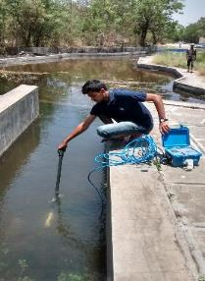
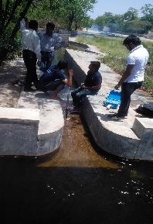
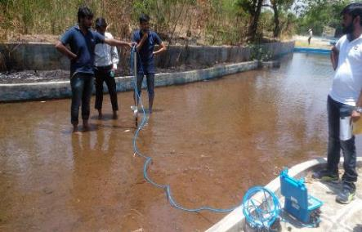
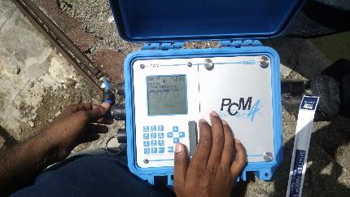
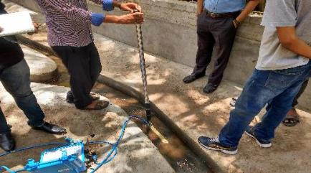
SUCCESSFUL TRIALS CARRIED OUT WITH THE OPEN CHANNEL FLOWMETER AT CWPRS

Slide 6

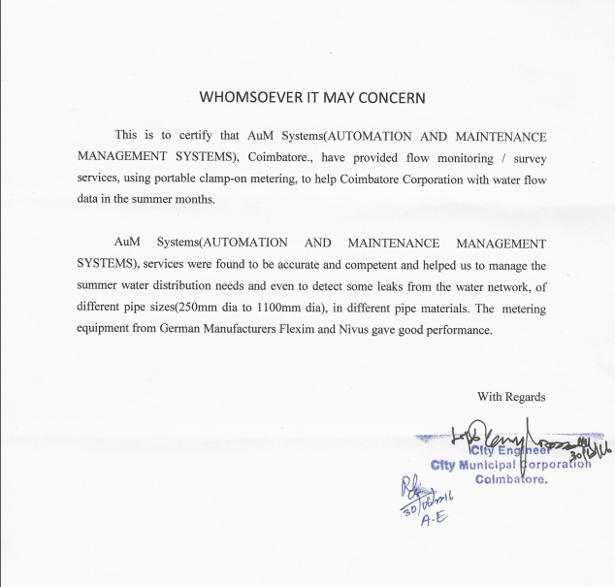
Appreciation Letter

Slide 7
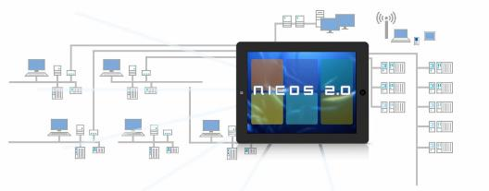








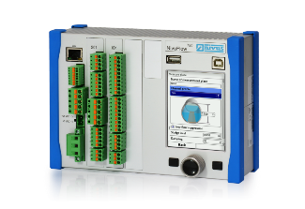








Solutions For Your Monitoring & Control Needs
Sensor Technology
SCADA/Teleprocessing
Cross Correlation
Doppler
Radar
Transmitter/RTU
Transit Time
Intelligent
Data
Trans-
mission
Level
Analysis
Parnerships which bring quality – Nivus, Germany

Slide 8
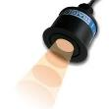
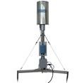
Flood Warning System
SCADA/Tele-Processing
Ultrasonic Level Sensor
Rain Gauge
Remote Satelite Monitoring System
GPRS
Data
Trans-
mission
Weather Station
OR

Slide 9
Ultrasonic Flow Measurement

Slide 10
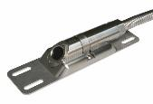
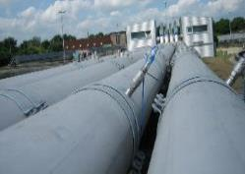

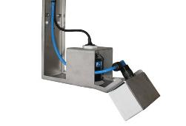
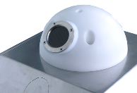
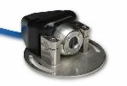
Sensor Technology
Clamp-On meters.
Insertion Pipe sensors.
Inside pipe wedge sensors.
Radar flow sensors.

Slide 11
LEVEL Measurement

Slide 12
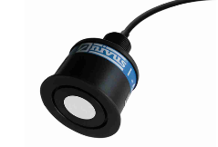
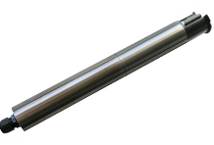
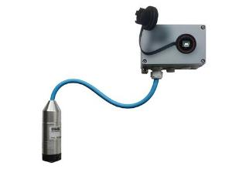
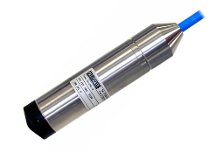
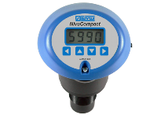
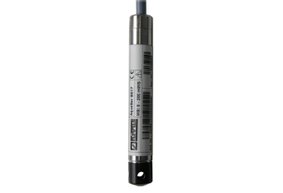
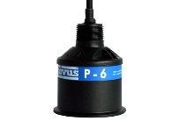
Sensor Technology

Slide 13
Transmission & Telecontrol solutions

Slide 14

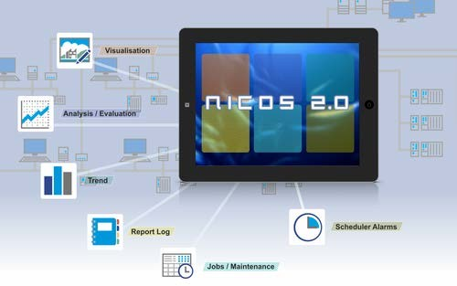
NICOS Overview…

Slide 15
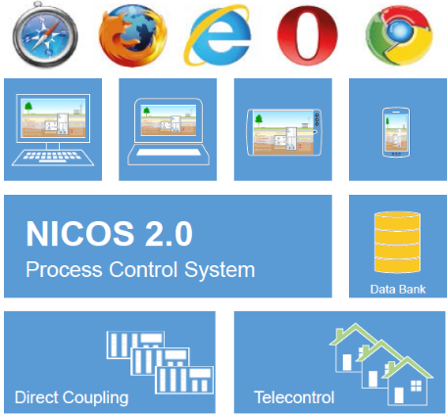
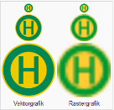
Features…
Web-enabled Process Control System
•Consistent web-visualization;
•Operation across all devices;
•Long-term archiving across different time zone;
•Process analysis;
•Monitoring and alarm functions;
•Reporting;
•Scalable as required;
•Consistently multi-client capable;
•Across all industries.
System Structure
• Consistent software solutions from one supplier;
• Visualization, archiving, alarms, hydrographs, reports
• Integrated industry-specific modules;
• Modular extension through license keys.

Slide 16
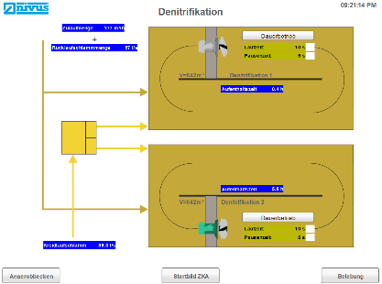
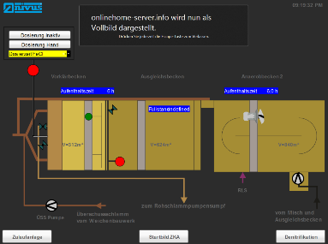
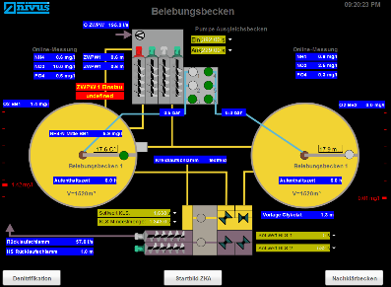
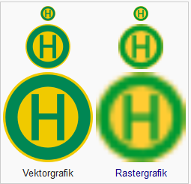
Visualization…
Support-Vector-Graphics - SVG
Sometimes a picture is worth a thousand words !!!

Slide 17
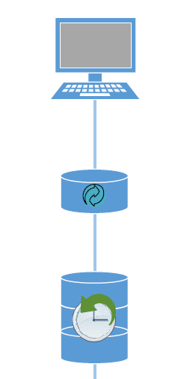





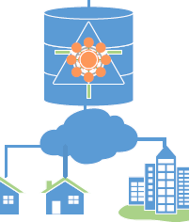
Construction…
Operator from smartphone
using anywhere module
Web Front End
Operator station
Database
Middleware
Tele control server for
Remote communication from Field
Engineering Station/ Development/
Alarm /Reporting/Communication driver
Runtime Server
To PLC/RTU/Logger/Transmitter

Slide 18
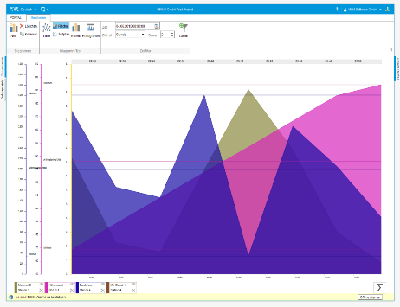
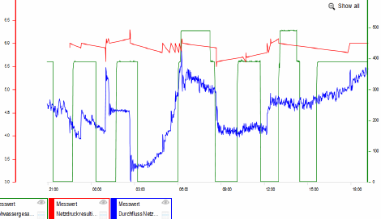
Process Analytics…
• Evaluation covering any free selectable period;
• Free combination of line, column, scatter and area charts;
• Zoom in x and y direction;
• Indication of min., max. and limit values;
• Crosshairs for targeted information;
• Compact summary of individual values indicated;
• Graphical analysis of all process data;
• Indication of archived and online values;
• Curves, hydrographs, trends;
• User-specific, storable compilation of curves;
• Simultaneous analog and digital indication;
• Summary and calculation functions.

Slide 19
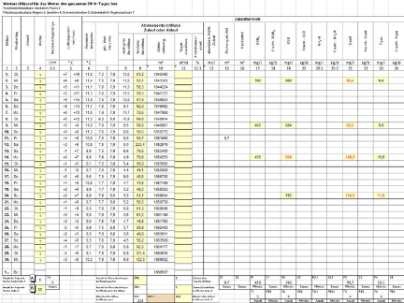
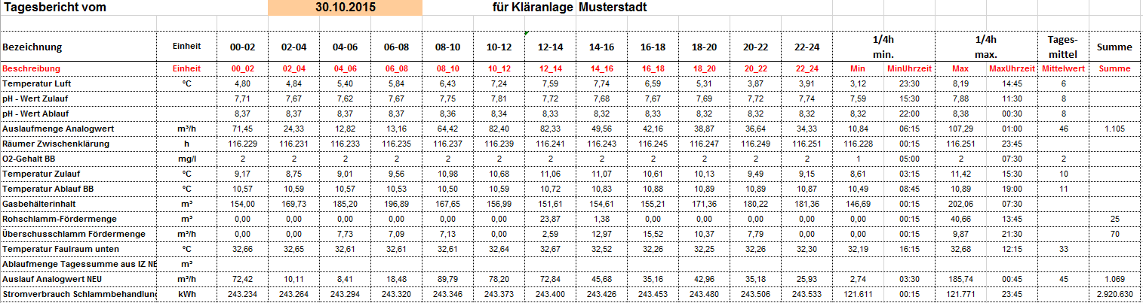
Reporting…
• Comprehensive management of reports;
• Industry-specific solutions ;
• Output of HTML, Excel and PDF documents;
• Indication as tables and charts;
• Calculation functions;
• Individually configurable.

Slide 20

Thank You !!!

